Slide 1
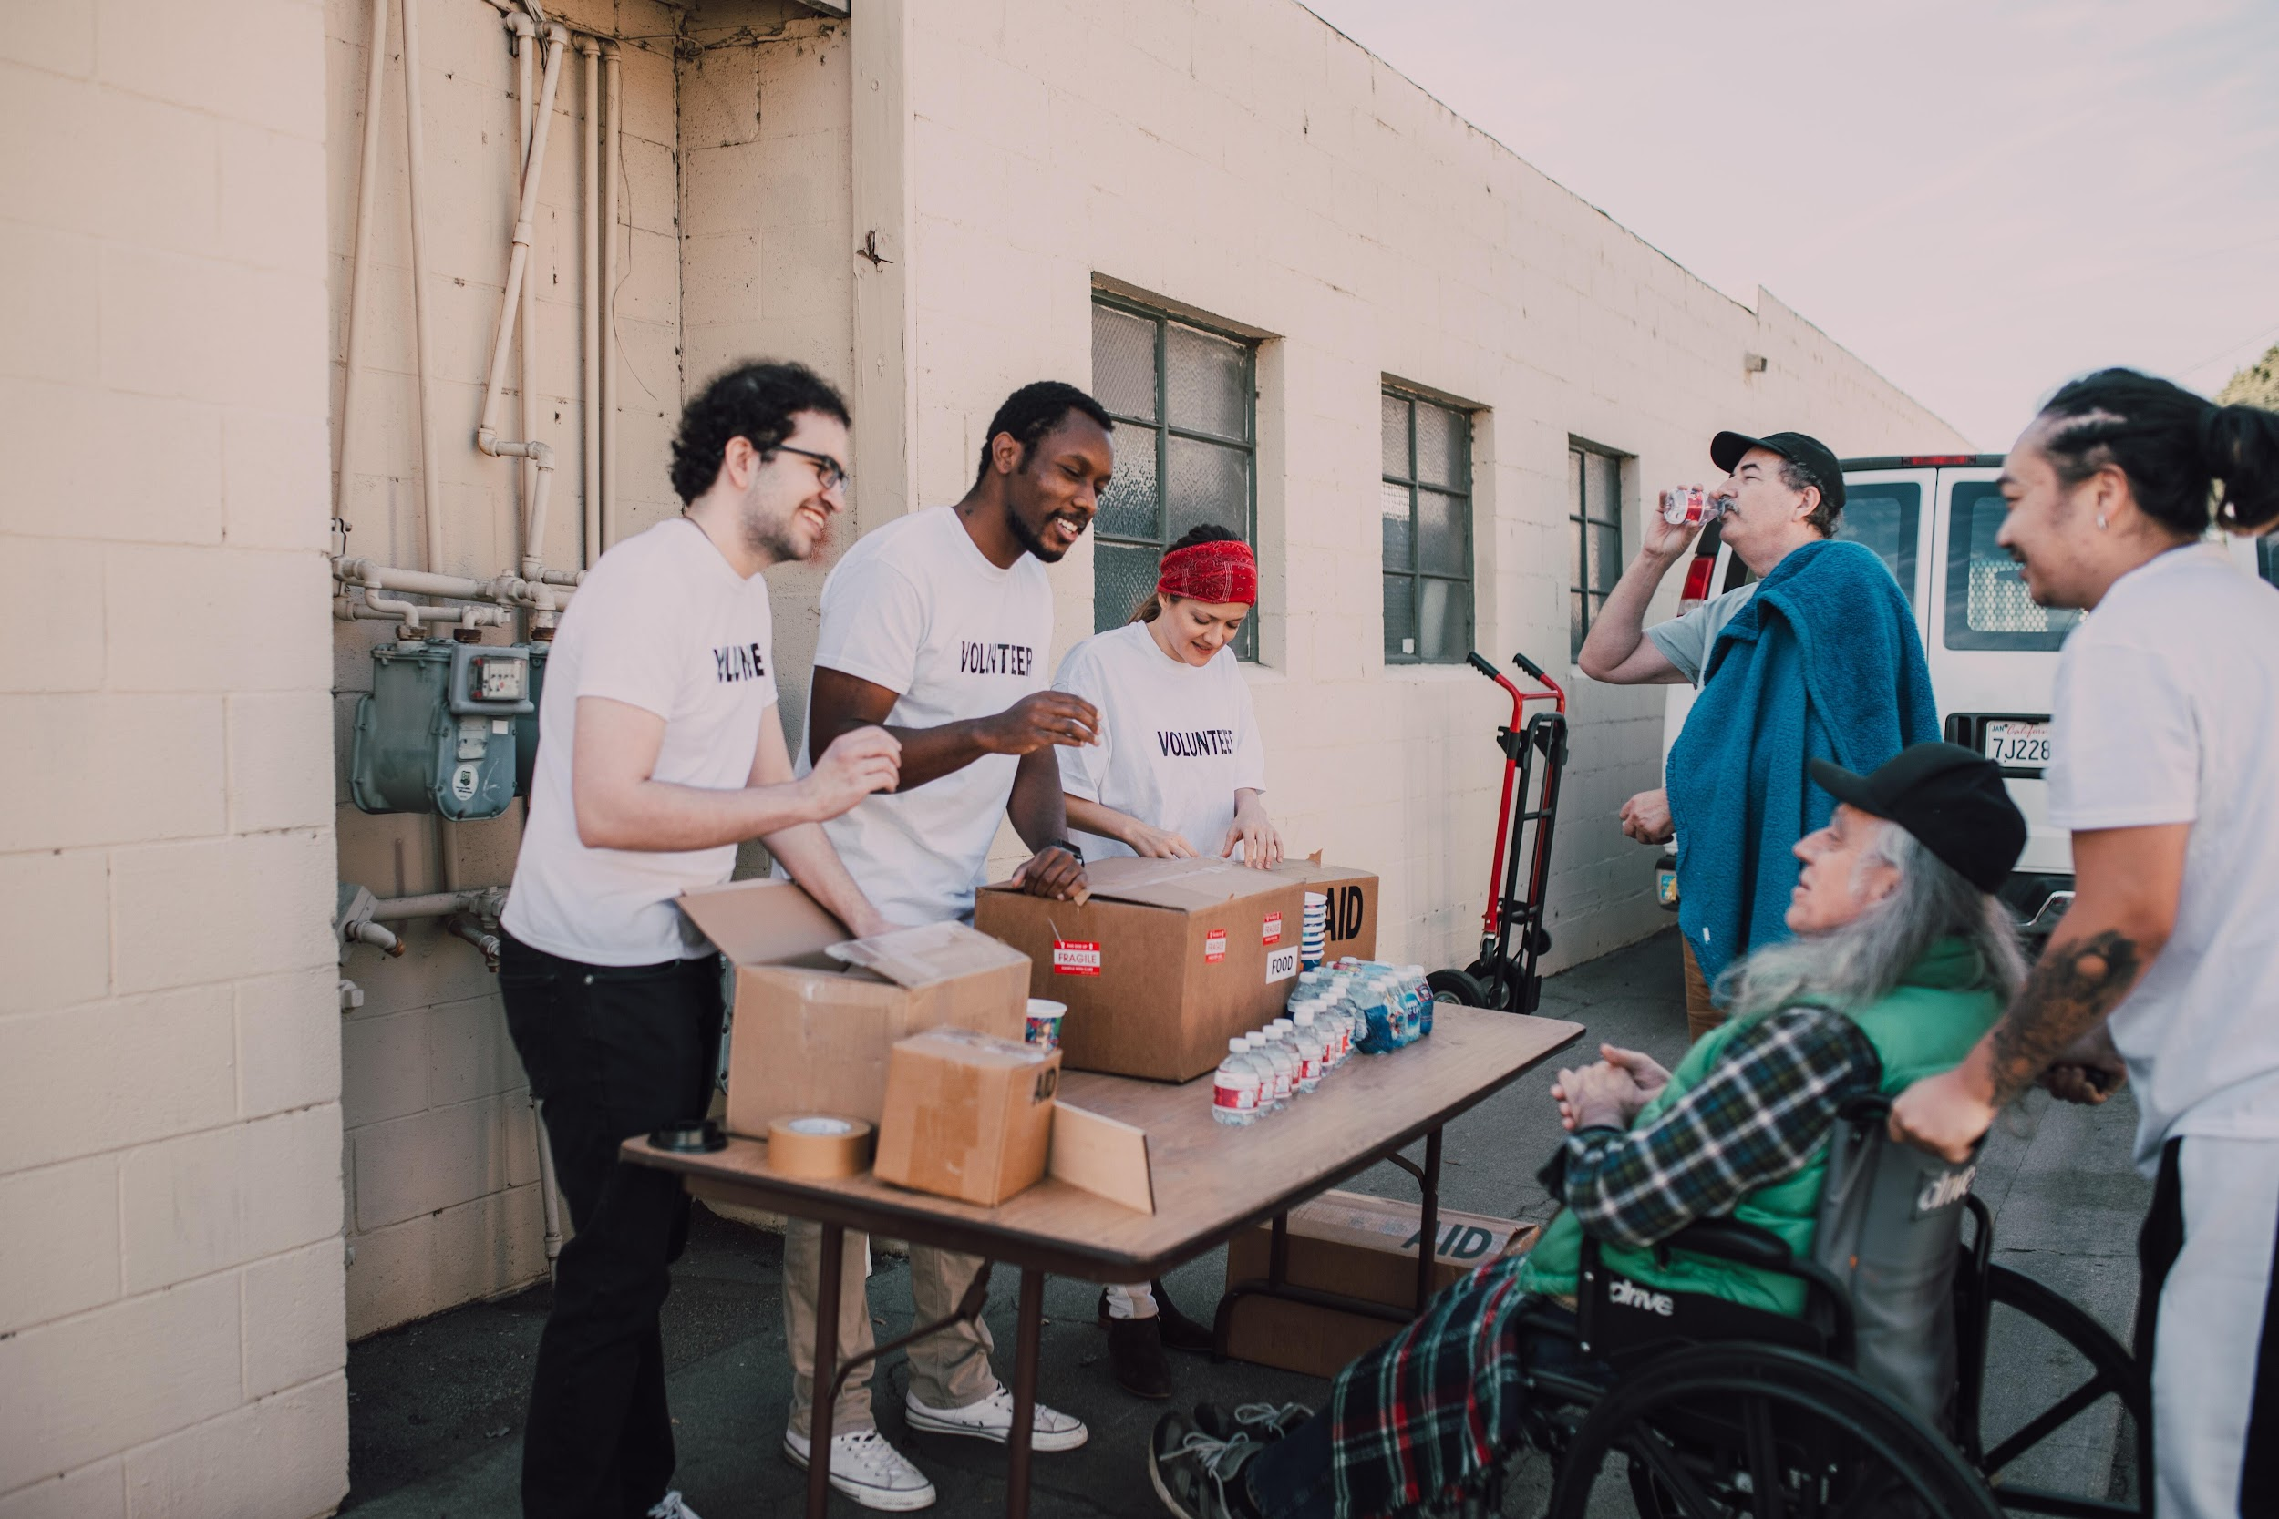
Food is Medicine
Community Resource Guide
Add website link here
© HealthBegins 2025. All rights reserved.

Slide 2
How to use this template
Purpose: This Community Resource Guide is a customizable template for Community Health Centers (CHCs) to develop their own resource lists for patients and community members experiencing food insecurity or in need of food-as-medicine interventions. The template includes sections for local food resources, food-as-medicine programs, eligibility criteria, contact information, and any additional notes relevant to your community.
Instructions for Using the Community Resource Guide Template:
Customize for your community:
Replace the placeholder content with specific information relevant to your region. This might include:
  Local food banks and pantries
  Community-supported agriculture (CSA) programs
  Farmers markets
  Clinics or organizations offering food-as-medicine services
  Culturally relevant food resources
  Nutrition education or cooking classes
Verify resource details:
Confirm that all contact information, hours of operation, and eligibility requirements are accurate and up to date.
Add language accessibility (if applicable): Consider translating the guide into the languages most commonly spoken by your patients or community members.
Distribute the guide: Once finalized, print and share the guide in your clinic waiting areas, at events, or during patient visits. You can also distribute it digitally via email, your website, or patient portal.
Update regularly: Community resources can change frequently. Set a reminder to review and update the guide on a regular basis (e.g., quarterly or biannually) to ensure it remains accurate and useful.
© HealthBegins 2025. All rights reserved.

Slide 3
Disclosure Notice
This Community Resource Guide is intended to serve as a reference for individuals and organizations seeking information on available programs and services. Please note that eligibility criteria for many programs, such as SNAP, Medi-Cal, and other public benefits are subject to change due to updates in federal, state, and local and legislative policies. For example, changes to immigration policies and/or status requirements may affect access to certain benefits.
Before sharing or distributing this guide, it is strongly recommended that all information be reviewed and updated to reflect the most current eligibility guidelines and program availability.
We encourage users to verify information with the relevant agency or service provider to ensure accuracy and appropriateness for those seeking support.
© HealthBegins 2025. All rights reserved.

Slide 4
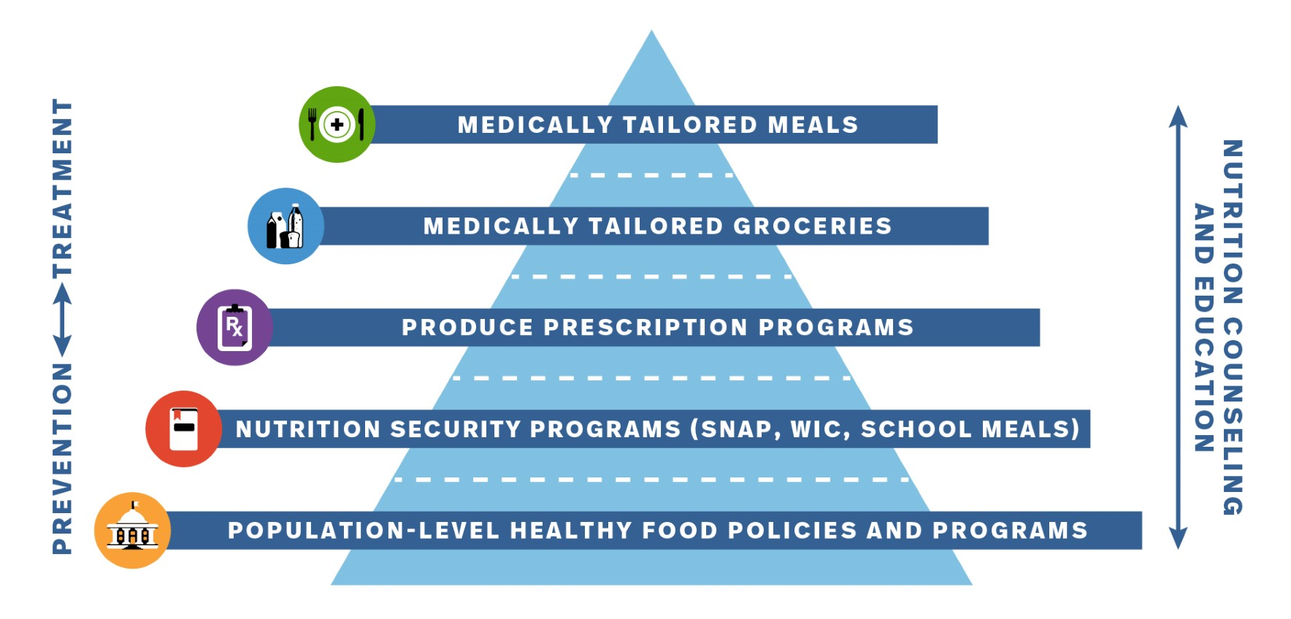
“What is Food is Medicine?”
Food is Medicine (FIM) programs show the strong connection between what we eat and our health. These programs give people healthy meals, groceries, or fresh produce that are chosen to help prevent or manage diseases. They are often part of a person’s health care plan and are connected to their medical treatment.
Programs may include:
Medically Tailored Meals (MTMs): Fully prepared meals made for people with specific health conditions (like diabetes, heart disease, or cancer). Designed by a registered dietitian and delivered to the patient.
Medically Tailored Groceries (MTGs): Bags of groceries chosen to fit a person’s medical needs, usually with some guidance on how to prepare them.
Produce Prescription Programs (Produce Rx): Vouchers or cards that patients can use to buy fresh fruits and vegetables at grocery stores or farmers markets.
Nutrition security programs: (SNAP, WIC, School Meals, CSA programs) Programs that help make sure people have enough healthy food to eat every day.
The Food is Medicine Pyramid
Source: https://tuftsfoodismedicine.org/wp-content/uploads/2024/04/Food-is-Medicine-Flyer-v2.pdf
© HealthBegins 2025. All rights reserved.

Slide 5
Food is Medicine State and Federal Benefits:
Enrollment and Eligibility
Accessing public benefits can be hard, but many programs are here to support you and your family. This section includes the most commonly accessed food related benefits, who may be eligible, who to contact, and how to apply.
Benefit or Program | Are you eligible? | How to enroll | Who to contact
CalFresh (Supplemental Nutrition Assistance Program (SNAP)): CalFresh benefits stretch food budgets, allowing individuals and families to afford nutritious food, including more fruit, vegetables and other healthy foods. | Individuals and families including U.S. citizens, legal residents, and noncitizens with certain immigration statuses may be eligible for CalFresh. Households need to have gross monthly income of less than or equal to the current limit to be eligible for CalFresh. Most adults age 18 to 50, who do not have a child in the home, must register to work or work at least 20 hours per week, or an average of 80 hours per month, to get CalFresh. People 60+ with a disability may have a higher income and still qualify. | To apply for CalFresh call the state-wide CalFresh hotline or contact the county directly. Applicants can find the contact information for their county in the phone book or online. Download an application from the Web: A person can also download a CalFresh application in a number of languages. Apply online: People can apply on-line using the BenefitsCal system. | CalFresh Benefits Helpline 1-877-847-3663 Or [Local or county administrator contact information]
California Food Assistance Program (CFAP) state-funded food benefits through the California Food Assistance Program (CFAP) for noncitizens who do not qualify for CalFresh benefits which are federally funded. | In order to be eligible to CFAP, noncitizens must currently be ineligible for CalFresh benefits solely due to their immigration status under the Personal Responsibility and Work Opportunity Reconciliation Act Lawful Permanent Residents (LPR) who have not met the five (5) year United States (U.S.) residency requirement or 40 qualifying work quarters criteria; Parolees, Conditional entrants; or Are battered or abused. | To apply for CFAP benefits, please visit CalFreshFood.org or contact your county office. CFAP and CalFresh use the same application. When you apply for CalFresh, the county will figure out if you are eligible for either CalFresh or CFAP. | CalFresh Benefits Helpline 1-877-847-3663 Or [Local or county administrator contact information]
Woman, Infants, and Children (WIC): WIC provides free, healthy foods and personalized nutrition education, breastfeeding support and referrals to other services. | WIC serves individuals who are pregnant, breastfeeding or chestfeeding, just had a baby (or recent pregnancy loss) in the last six months; or Individuals who have a child or care for a child under age 5; and Have low-to-medium income or receive Medi-Cal, CalWORKs (TANF), or CalFresh (SNAP) benefits; and Live in California. WIC pre-screening eligibility tool | To apply for WIC benefits, you must make an appointment at a WIC local agency. WIC has local offices all over California. Set up an appointment at an office near you. WIC Office Search. | Toll free contact number: 1-800-852-5770 [Local or county administrator contact information]
© HealthBegins 2025. All rights reserved.

Slide 6
Food is Medicine State and Federal Benefits:
Enrollment and Eligibility
Benefit or Program | Are you eligible? | How to enroll | Who to contact
WIC Farmers' Market Nutrition Program (FMNP): The WIC FMNP provides one booklet of three $10 checks ($30 total) to eligible households for use at WIC authorized Farmers’ Markets between May 1 and November 30 each year. | FMNP serves the participant that have been certified to receive WIC program benefits. Eligible WIC participants are issued FMNP coupons in addition to their regular WIC benefits. | To apply for WIC benefits, you must make an appointment at a WIC local agency. WIC has local offices all over California. Set up an appointment at an office near you. WIC Office Search. | Toll free contact number: 1-800-852-5770 [Local or county administrator contact information]
Senior Farmers' Market Nutrition Program (SFMNP): The SFMNP program provides low-income seniors with access to locally grown fruits, vegetables, honey and herbs. | Low-income seniors, generally defined as individuals who are at least 60 years old and who have household incomes of not more than 185% of the federal poverty income guidelines. | To apply for the Senior Farmers Market Nutrition Program (SFMNP), you'll need to contact your local Area Agency on Aging (AAA) | Find your local AAA by selecting your county on the "Find Services in My County" page of this website. [Local or county administrator contact information]
Market Match Program: Market Match is California’s largest nutrition incentive program that gives extra money to shoppers enrolled in CalFresh (California’s Supplemental Nutrition Assistance Program) for fruits and vegetables at farmers’ markets and other farm-direct outlets (farm stands, CSAs, and mobile markets). | Must be a CalFresh (SNAP) cardholder. Some markets also accept WIC benefits. | To enroll in the Market Match program in California, you first need to be enrolled in CalFresh. Then, you can use your CalFresh card at participating farmers' markets to receive Market Match. | Find the farmers’ market or other farm-direct outlet nearest you that offers Market Match. You can use the Farmers’ Market Finder map to search for farmers’ markets and farm-direct outlets near you that accept CalFresh EBT and offer Market Match.
© HealthBegins 2025. All rights reserved.

Slide 7
Food is Medicine State and Federal Benefits:
Enrollment and Eligibility
Benefit or Program | Are you eligible? | How to enroll | Who to contact
Food Distribution Program on Indian Reservations (FDPIR): Provides food assistance to eligible households living on or near Indian reservations and in designated areas in Oklahoma | American Indian and non-Indian households living on a reservation. Households residing in an approved area that include at least one member of a federally recognized Tribe. FDPIR applicants also have to meet certain income eligibility requirements. While most households must be recertified for benefits every 12 months, those with older adults and individuals who have a disability may be certified for up to 24 months. FDPIR beneficiaries cannot participate in SNAP (CalFresh) at the same time. | To enroll in the FDPIR in California, you'll need to contact your local Indian Tribal Organization (ITO) or state agency. You can also reach out to the USDA's Food and Nutrition Service (FNS) regional office for assistance. | Contact your local ITO. [Local Tribal office/administrator contact information.]
Older Californians Nutrition Program (OCNP): The OCNP offers both congregate meals and home-delivered meals across all 58 counties in California. | Individuals 60 or older and/or have limited ability to leave home unassisted or to shop for and prepare nutritious meals A spouse of a participant (any age) A person with a disability living at a site where the program is provided | To apply for the Older Californians Nutrition Program (OCNP), you'll need to contact your local Area Agency on Aging (AAA). | Find your local AAA by selecting your county on the "Find Services in My County" page of this website. [Local or county administrator contact information]
[List benefit or program] | [List eligibility criteria] | [List enrollment information] | [Local office and/or administrator contact information.]
© HealthBegins 2025. All rights reserved.

Slide 8
Food is Medicine State and Federal Benefits:
Enrollment and Eligibility
Benefit or Program | Are you eligible? | How to enroll | Who to contact
National School Lunch Program (NSLP): federally assisted meal program operating in public and nonprofit private schools and residential child care institutions. It provides nutritionally balanced, low-cost or free lunches to children each school day. | Your child is eligible for free schools meals if your household meets the gross monthly income of less than or equal to the current limit to be eligible for CalFresh; your household receives benefits like CalFresh, SNAP, or cash assistance; your child is in foster care, is a child of migrant workers, or is experiencing homelessness; your child participates in the Head Start program; or your child is eligible for reduced price meals. Eligibility flyer | Families typically apply through their child's school, usually at the beginning of the school year or when circumstances change. Applications are reviewed by school or district officials to determine eligibility for free or reduced-price meals. | Contact your local school at any time to see if your children are eligible.
Summer Meals and Snacks for Kids: Through SUN Meals, kids of all ages can eat meals and snacks during the summer at no cost at schools, parks, and other neighborhood locations. SUN Meals may have a different name where you live, but the benefit is the same: nutritious meals for kids and teens in the summer when school is out. | SUN Meals are available to any child aged 18 and under, no application needed. | No application needed. | CA Meals for Kids Mobile Application: https://www.cde.ca.gov/re/mo/cameals.asp Find a site here https://www.cde.ca.gov/ds/sh/sn/summersites25.asp And Here: https://www.fns.usda.gov/summer/sitefinder
Summer Grocery Benefit for Kids: This food program provides families $40 per month for food in June, July, and August (up to $120 total/month/child) when children do not have access to school meals. | Most children who qualify for free or reduced-price school meals through a school meal application or Universal Benefits Application, or get CalFresh, CalWORKs, and/or Medi-Cal, are automatically enrolled. Children in foster care, experiencing homelessness, attending Head Start, and/or are considered a runaway are also categorically eligible and are automatically enrolled. Some children may need to sign up. Participating in SUN Bucks does not affect a family’s immigration status. | Children who are not automatically enrolled may still be eligible for SUN Bucks. To qualify, a child’s household must meet certain income limits and other requirements. Apply directly to the agency that administers SUN Bucks in your state, Tribe, or territory. | SUN Bucks helpline is available at (877) 328-9677
© HealthBegins 2025. All rights reserved.

Slide 9
Food is Medicine
Find Local Community Based Organizations or Resources
Organization or Tool | About | How can this tool support you? | Contact Information
211 | United Way’s national resource database | 211 connects you to community resources in your area like food assistance, housing, healthcare, transportation, and more. | You can dial 211 or send a text to get quick access to services or information. It’s available 24/7 and is free to use. https://www.unitedwaysca.org
Food is Medicine Coalition | The Food is Medicine Coalition (FIMC) is a national coalition of nonprofit organizations that provide medically tailored meals (MTMs) and groceries (MTGs), medical nutrition therapy and nutrition counseling and education to people in communities across the country. | The national FIM coalition can connect you to a Nationwide Network of Agencies connecting you with nonprofit organizations across the country that provide FIM services. | Find a FIMC agency: https://fimcoalition.org/find-agency/
California Food is Medicine Coalition | The California Food is Medicine Coalition is the leading coalition of medically tailored meal providers for low-income Californians with chronic or severe illnesses. | The Coalition provides you with guidance for identifying services, while CalFIMC itself doesn’t directly sign people up for services, it connects you with healthcare providers and health plans to get you referred to FIM services if you qualify. | Find a member agency: https://www.calfimc.org/member-agencies-1
AAFP Foundation EveryONE Project's Neighborhood Navigator | An interactive online tool that connects you to community resources and programs in your neighborhood. | The Neighborhood Navigator is an online tool that helps you find local community resources and services in your area ike food programs, housing support, healthcare, and more. | Find services nearby: You can search for services by your zip code. https://navigator.aafp.org/
[Name] | [Details about the organization or tool] | [Services provided by the organization or tool] | [Link to website, address, phone, etc.]
© HealthBegins 2025. All rights reserved.

Slide 10
Food is Medicine
Find Local Community Based Organizations or Resources
Organization or Tool | About | How can this tool support you? | Contact Information
California Association of Food Banks | CAFB works alongside 41 member food banks and on behalf of hungry Californians. CAFB ensures food banks have the tools and resources they need, so they can focus on what they do best: feed their communities. | No matter where you are in California, CAFB helps connect you to local food banks that can provide meals, groceries, and other food resources. If you're looking for food assistance, you can connect to one of the 41 food banks CAFB supports across California. | Ask your healthcare provider or local social service agency to guide you to the nearest food bank or visit CAFB’s website to find food resources in your area. https://www.cafoodbanks.org/our-members/
[Name] | [Details about the organization or tool] | [Services provided by the organization or tool] | [Link to website, address, phone, etc.]
[Name] | [Details about the organization or tool] | [Services provided by the organization or tool] | [Link to website, address, phone, etc.]
© HealthBegins 2025. All rights reserved.

Slide 11




Community Supports (Medically Tailored Meals/Medically Supportive Foods)
Connect with your Medi-Cal health insurance provider
What are Medically Tailored Meals (MTM)?
A MTM is a meal delivered to individuals of all ages who live with severe, chronic, or complex illness(es) and/or experience activities of daily living limitations, as deemed necessary by a healthcare professional. A Registered Dietitian Nutritionist (RDN) tailors meal plans to meet the medical needs of the individual.
What are Medically Supportive Foods (MSF)?
MSF provide access to preselected whole foods that adhere to national nutrition guidelines to prevent, manage, or reverse nutrition-sensitive conditions of referred Members this may include, tailored groceries, healthy food vouchers, and food pharmacies.
Who is eligible for MTM or MSFs?
Medi-cal managed care plan members or individuals who have chronic or other serious health conditions that are nutrition sensitive such as (but not limited to) cancer, cardiovascular disorders, chronic kidney disease, chronic lung disorders or other pulmonary conditions such as asthma/COPD, heart failure, diabetes, other metabolic conditions, etc.
Interested in learning more?
Contact your designated Medi-Cal Managed Care Plan (health insurance provider), as they may have a specific process for referring members to medically tailored meals programs.
Medi-Cal Managed Care Plan | Contact Information (Link, phone, etc.) | Service Area(s)
[Name of Medi-Cal health insurance provider eligible to reimburse MTM/MSF services] | [List all relevant contact information, for example, referral link, phone, etc.] | [List region or county]
[Name of Medi-Cal health insurance provider eligible to reimburse MTM/MSF services] | [List all relevant contact information, for example, referral link, phone, etc.] | [List region or county]
[Name of Medi-Cal health insurance provider eligible to reimburse MTM/MSF services] | [List all relevant contact information, for example, referral link, phone, etc.] | [List region or county]
[Name of Medi-Cal health insurance provider eligible to reimburse MTM/MSF services] | [List all relevant contact information, for example, referral link, phone, etc.] | [List region or county]
© HealthBegins 2025. All rights reserved.

Slide 12
Connect with your local Medically Tailored Meals/Medically Supportive Foods providers
What are Medically Tailored Meals (MTM)?
A MTM is a meal delivered to individuals of all ages who live with severe, chronic, or complex illness(es) and/or experience activities of daily living limitations, as deemed necessary by a healthcare professional. A Registered Dietitian Nutritionist (RDN) tailors meal plans to meet the medical needs of the client according to the MTM Nutrition Standards. MTMs are designed to improve health outcomes, lower cost of care and increase client satisfaction.
What are Medically Supportive Foods (MSF)?
Tailored groceries, healthy food vouchers, and food pharmacies.
Who is eligible for MTM or MSFs?
Medi-cal managed care plan members or individuals who have chronic or other serious health conditions that are nutrition sensitive such as (but not limited to) cancer, cardiovascular disorders, chronic kidney disease, chronic lung disorders or other pulmonary conditions such as asthma/COPD, heart failure, diabetes, other metabolic conditions, etc.
Interested in learning more?
Contact the providers below, as they may have a specific process for referring you or a family member to medically tailored meals programs.
Provider or Community Based Organization | Food is Medicine Services Provided | Contact Information (Link, phone, etc.) | Service Area(s)
[Organization name: Moms Meals, Ceres Community Project, etc.] | [Food Rx, MTM, Food vouchers, grocery boxes…] | [List information to referral contact or coordinator] | [List county or city]
Development of this editable template was possible thanks to HealthBegins—a national design and implementation partner that helps Medicaid-serving clients move upstream and advance health equity for people and communities harmed by societal practices.This MOU was informed by templates created by HealthBegins. All adaptations and final wording are the responsibility of [Your Organization]
This work was supported by a sub-award through Tufts University from the Kaiser Foundation Health Plan, and in collaboration with HealthBegins and the project team at the Food is Medicine Institute at the Friedman School of Nutrition Science and Policy at Tufts University.
© HealthBegins 2025. All rights reserved.

